Slide 1
Healthcare Analysis
Project Report
Aparna Nair
aparna.nair.vijay@gmail.com

Slide 2
Business Scenario
A nationwide survey of hospital costs conducted by the US Agency for Healthcare consists of hospital records of inpatient samples. The given data is restricted to the city of Wisconsin and relates to patients in the age group 0-17 years. The agency wants to analyze the data to research on healthcare costs and their utilization.
Domain: Healthcare

Slide 3
Objectives
Find the age category of people who frequently visit the hospital and has the maximum expenditure.
Understand the diagnosis-related group that has maximum hospitalization and expenditure
Analyze if the race of the patient is related to the hospitalization costs.
Analyze the severity of the hospital costs by age and gender for the proper allocation of resources.
Validate if length of stay can be predicted from age, gender, and race.
Understand the factors/variables that mainly affects hospital costs.

Slide 4
Dataset Description
Dataset has 500 observations of 6 variables
Attribute | Description
Age | Age of the patient discharged
Female | A binary variable that indicates if the patient is female
Los | Length of stay in days
Race | Race of the patient (specified numerically)
Totchg | Hospital discharge costs
Aprdrg | All Patient Refined Diagnosis Related Groups

Slide 5
Data exploration
Removed Missing value (NA ) in Race attribute by using na.roughfix and replaced the NA value with median ( median and minimum value is 1)
Used cut function to create groups for Age objectives 1 and added as new variable in the dataframe.
During Linear regression model, avoided the new variable for Age group.

Slide 6
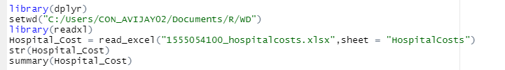
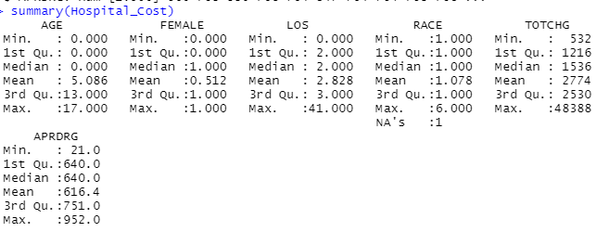
Statistical algorithm execution – Rcode and outputs
Importing the Data Set and analysing the data
Output

Slide 7

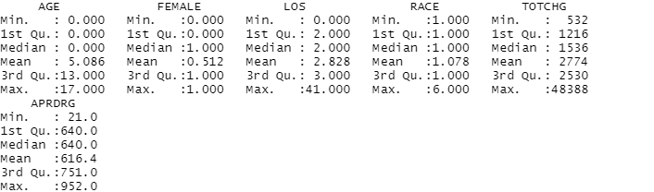
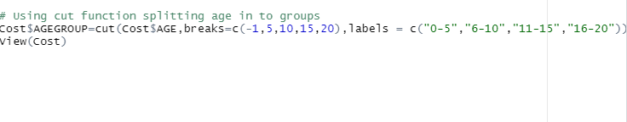
Statistical algorithm execution – Rcode and outputs
Removing missing value from Race attribute by median using na.roughfix function
Output
Using cut function created groups for Age attribute (used in first objective)

Slide 8
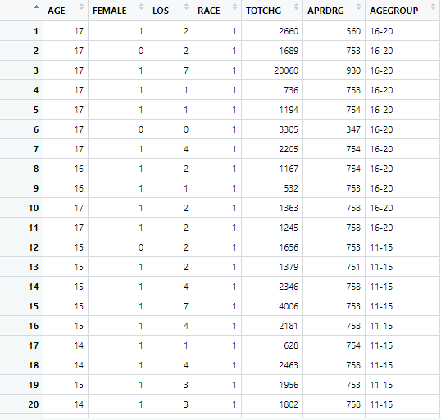
Statistical algorithm execution – Rcode and outputs
Output

Slide 9
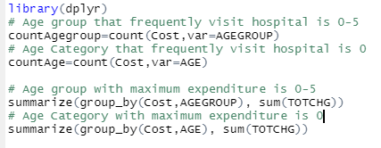
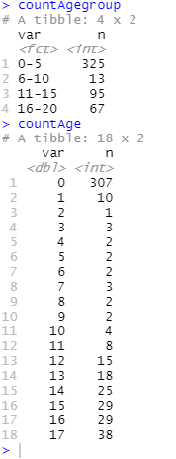
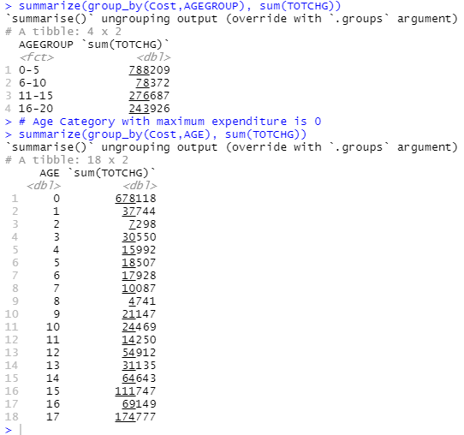
Statistical algorithm execution – Rcode and outputs
Objective 1 - Find the age category of people who frequently visit the hospital and has the maximum expenditure.
Output

Slide 10
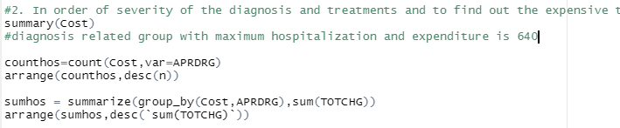
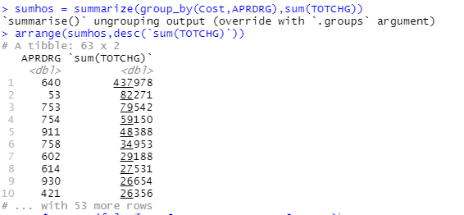
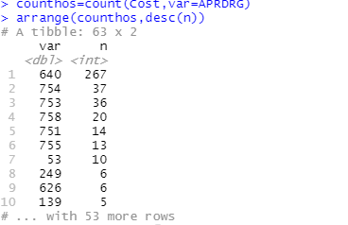
Statistical algorithm execution – Rcode and outputs
Objective 2 – Understand the diagnosis-related group that has maximum hospitalization and expenditure

Slide 11
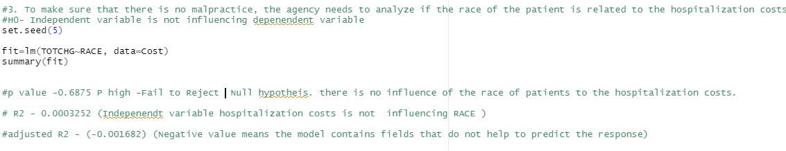
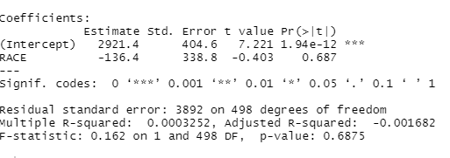
Statistical algorithm execution – Rcode and outputs
Objective 3 - Analyze if the race of the patient is related to the hospitalization costs.
Output

Slide 12
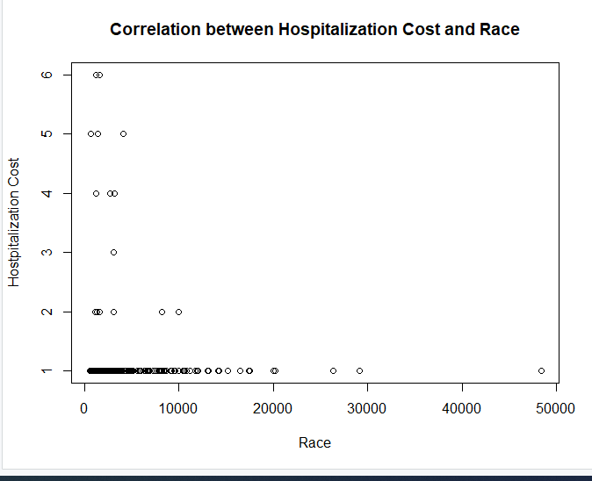
Statistical algorithm execution – Rcode and outputs

Slide 13


Statistical algorithm execution – Rcode and outputs

Slide 14
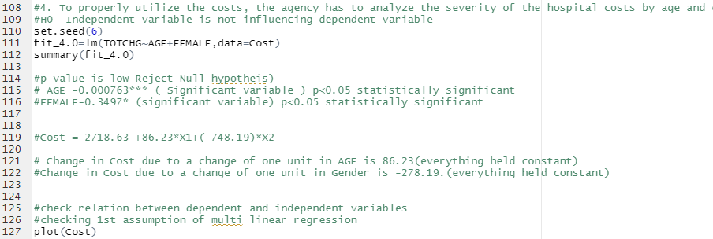
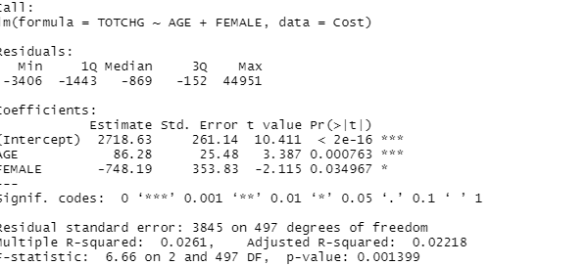
Statistical algorithm execution – Rcode and outputs
Objective 4 - Analyze the severity of the hospital costs by age and gender for the proper allocation of resources

Slide 15
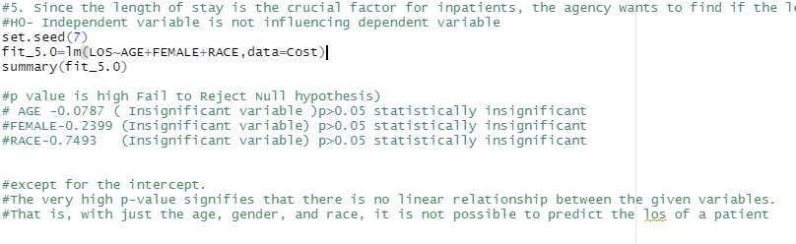
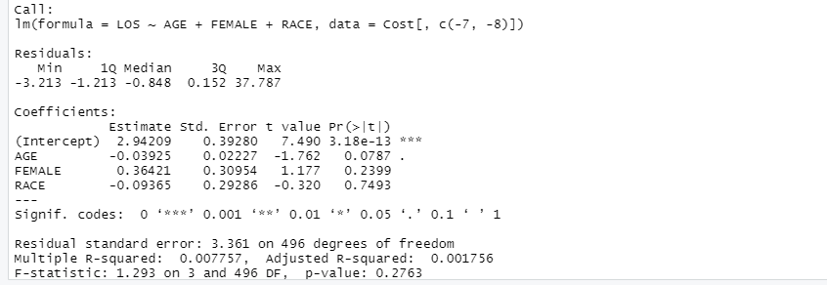
Statistical algorithm execution – Rcode and outputs
Objective 5 - Validate if the length of stay can be predicted from age, gender, and race.
Output

Slide 16
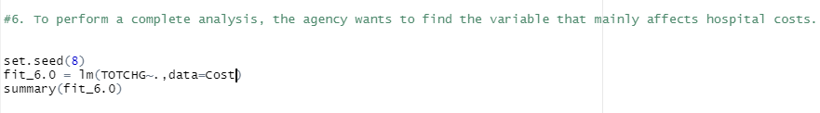
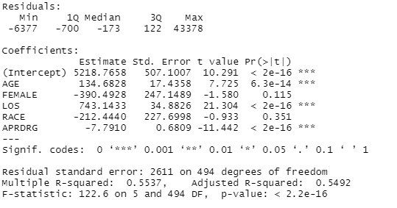
Statistical algorithm execution – Rcode and outputs
Objective 6 - Find the variable that mainly affects hospital costs.
Building linear regression model with all variables
Output
p value is high for Female and Race attribute making them insignificant variables

Slide 17

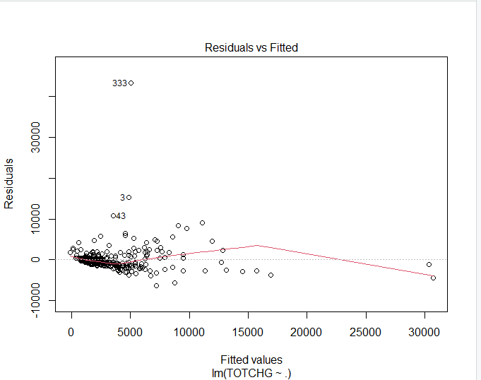
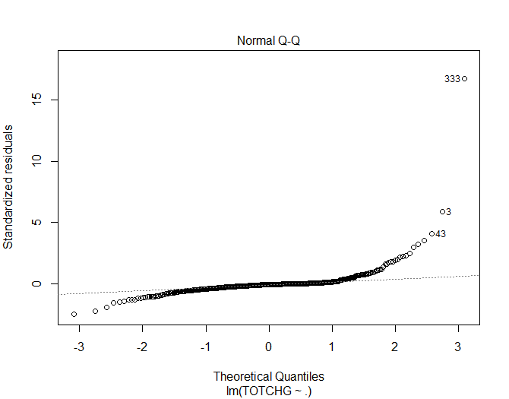
Statistical algorithm execution – Rcode and outputs
No Homoskedasticity and Normality observed for model fit_6.0

Slide 18

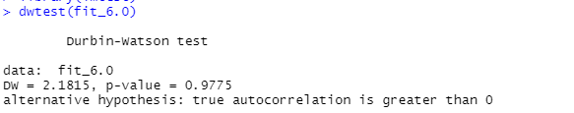
Statistical algorithm execution – Rcode and outputs
High p value indicated there is no correlation between error for model fit_6.0

Slide 19

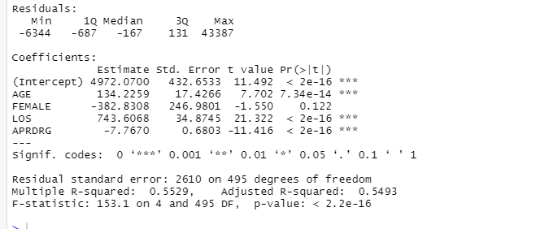
Statistical algorithm execution – Rcode and outputs
Second model fit_6.1 after dropping Race attribute. High p value for Female attribute is observed making it an insignificant variable

Slide 20

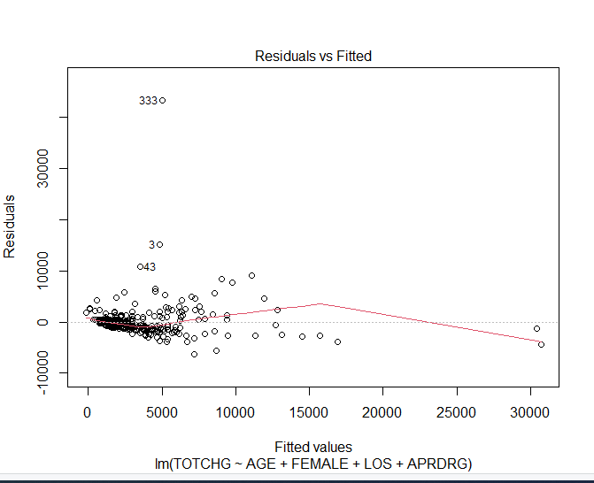
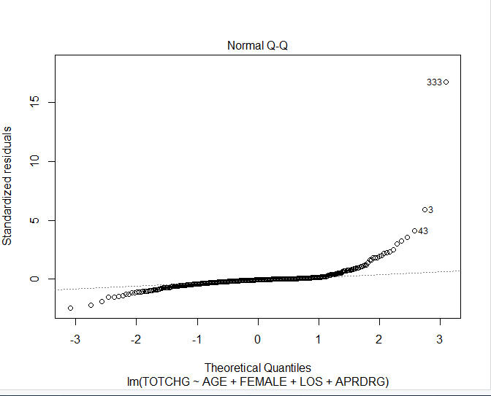
Statistical algorithm execution – Rcode and outputs
No Homoskedasticity and Normality observed for model fit_6.1

Slide 21

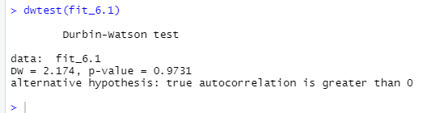
Statistical algorithm execution – Rcode and outputs
High p value indicated there is no correlation between error for model fit_6.1

Slide 22
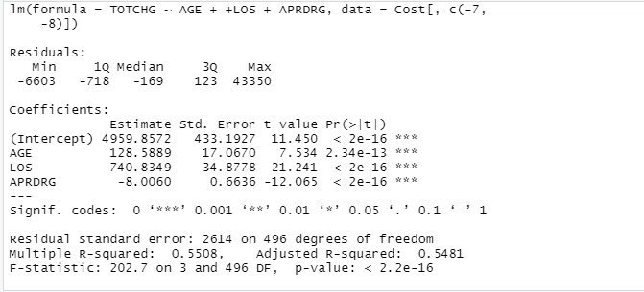
Statistical algorithm execution – Rcode and outputs
Build model fit_6.2 by dropping Race and Female (Gender) attribute. It was observed that independent variables Age,Los and Aprdrg are having very low p value(Signif.codes ***) making them significant variables .

Slide 23

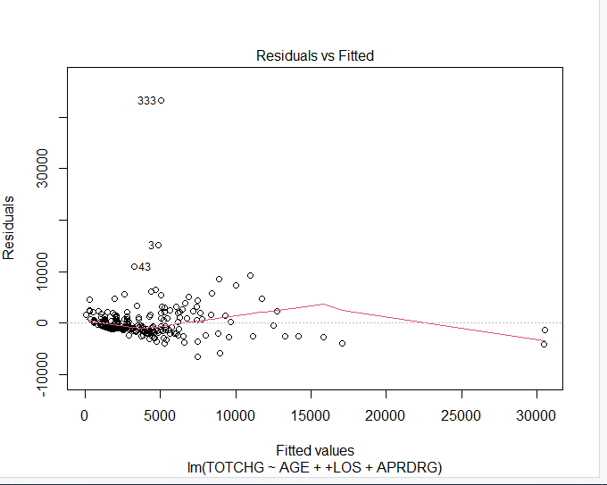
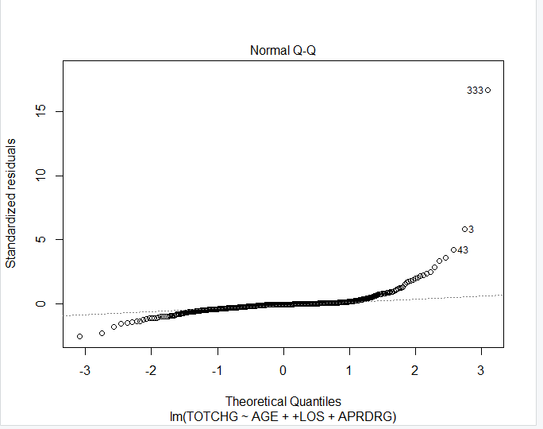
Statistical algorithm execution – Rcode and outputs
No Homoskedasticity and Normality observed for model fit_6.1

Slide 24

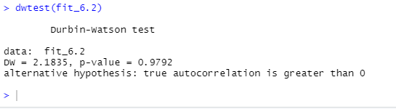
Statistical algorithm execution – Rcode and outputs
High p value indicated there is no correlation between error for model fit_6.2

Slide 25

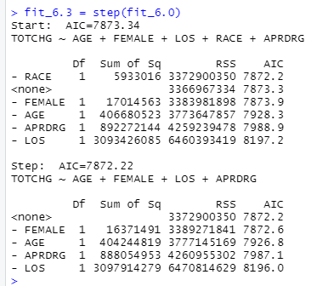

Statistical algorithm execution – Rcode and outputs
Lowest AIC value is 7872.2 which is indicating towards of model fit_6.1

Slide 26
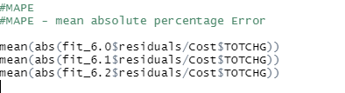
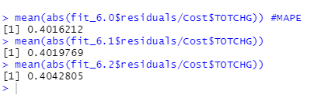
Statistical algorithm execution – Rcode and outputs
MAPE value for all the 3 models are almost the same with very less difference

Slide 27
Summary of models
Inference
From the above summary for linear regression it is observed that :
There is not much difference found in MAPE for the 3 linear regression model
AIC is better for model fit_6.1 ,but it has an insignificant variable Female present.
Autocorrelation is good for all the 3 models
The three models are not showing very good homoskedasticity and normality
The model with the least difference of R2 and adjusted R2 is model fit_6.2 and all the variables are significant . Thus it is given priority 1

Slide 28
Result
Objective 1-Find the age category of people who frequently visit the hospital and has the maximum expenditure.
0 Age category(infants)are the patients who frequenty visit the hospital (307 times)and have the maximum expenditure (678118) .(Refer Slide 9)
Objective 2 – Understand the diagnosis-related group that has maximum hospitalization and expenditure
640 was the diagnosis related group that had maximum hospitalization(267) and maximum expenditure(437978) (Refer Slide 10)
Objective 3 -Analyze if the race of the patient is related to the hospitalization costs.
There is no influence on hospitalization cost by the race of the patient .Linear regression model built with Cost as dependent variable and race of the patient as indepenent variable had very high p value (0.6875, p>0.05)making it an insignificant variable for hospitalization costs.(Refer Slide 11)
Also from the Scatter plot(Refer Slide 12) and Correlation matrix(Refer Slide 13) it was conlcuded that the variables are not having linear relationship

Slide 29
Result
Objective 4-Analyze the severity of the hospital costs by age and gender for the proper allocation of resources.
From the Linear regression model built for dependent variable hospital costs by independent variable age and gender ,p value was low (<0.05) for both variables age and gender making them significant variables. Thus it was concluded that the Hospital costs are dependent on the age and gender.(Refer Slide 14)
Objective 5 - Validate if length of stay can be predicted from age, gender, and race.
From the Linear Regression model built for dependent variable Length of stay and independent variable age,gender and race , it was found that p value was high for all the three variables making them insignificant variables.(Refer Slide 15)
Thus the inference, length of stay cannot be predicted from age,gender and race
Objective 6 - Understand the factors/variables that mainly affects hospital costs.
After building different linear regression model (3 models) and using method of significance,step approach AIC(Akaike information criterion),MAPE (Mean absolute percentage error),homoskedasticity,normality and autocorrelation of errors, it was concluded that the factors affecting hospital costs are Age,Length of stay and diagnosis related group(Refer Slide 16-27)

